Slide 1
DOCUMENT CLASSIFICATION | GRAPH | KNN
Presented by:
2021-CS-15 Aleeza Shakeel
2021-CS-51 Laiba

Slide 2
Graph Theory!

Slide 3
01
02
TABLE OF CONTENTS
03
04
Data Collection and Preparation
Graph Construction
Feature Extraction via common Subgraph
Classification with KNN
Making Confusion Matrix
05

Slide 4
01
DATA COLLECTION AND PREPARATION

Slide 5
Project Topics for data collection
Travel
Science and Education
Diseases and Symptoms
Data Scrapping from different travelling websites
Data Scrapping from different Science and Education websites
Data Scrapping from different Diseases and it’s Symptoms websites

Slide 6
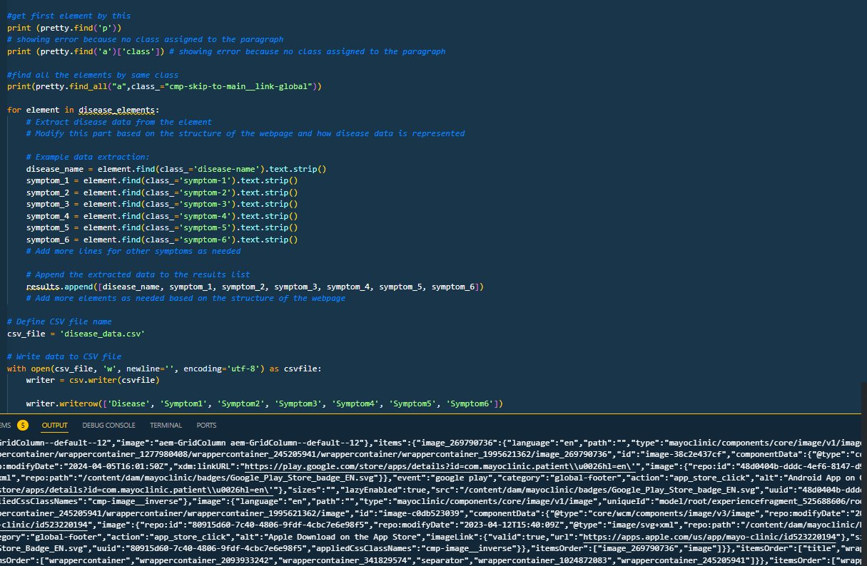
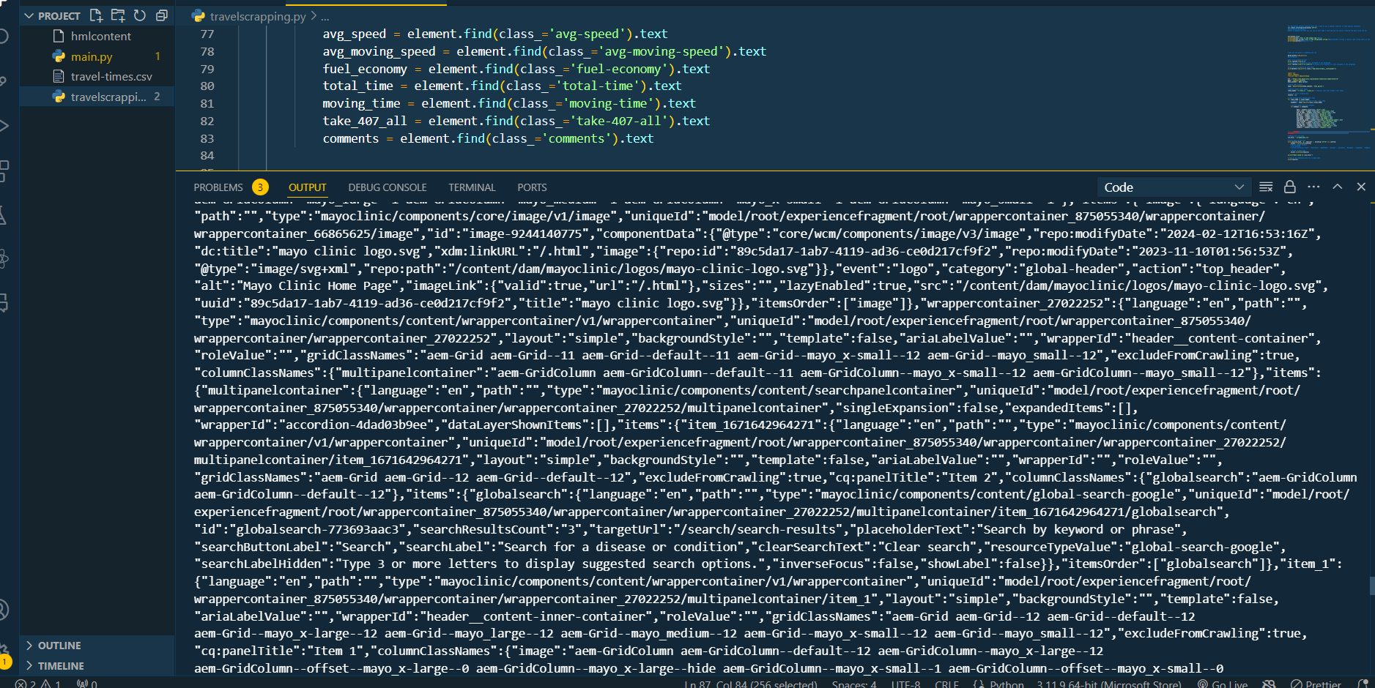
—Scrapping Code:

Slide 7
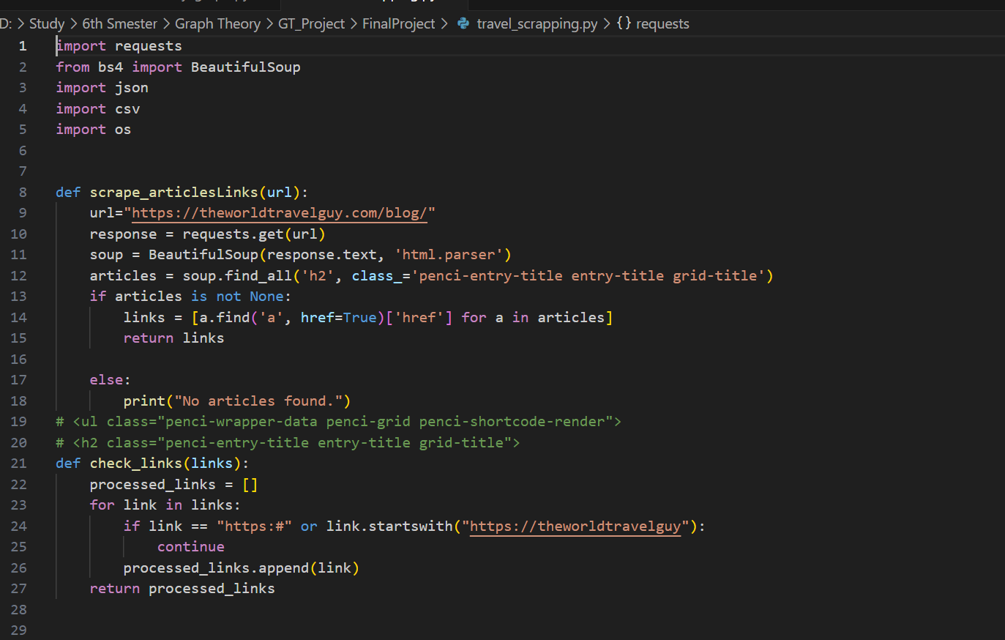
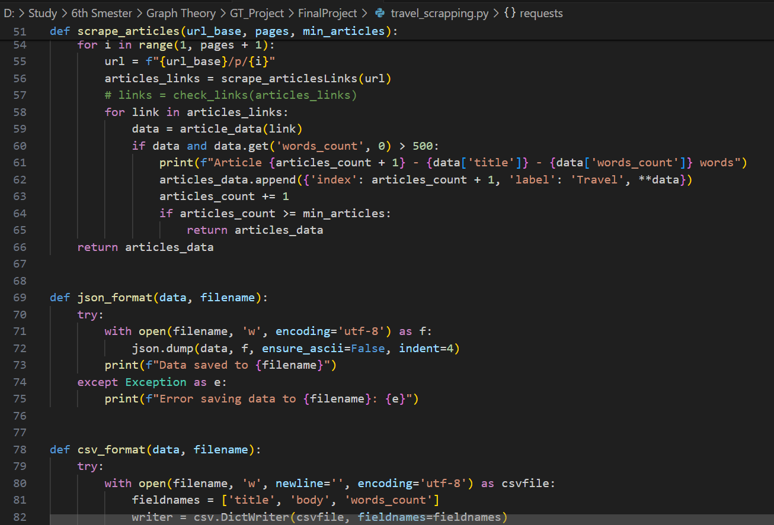
—Scrapping Code:

Slide 8
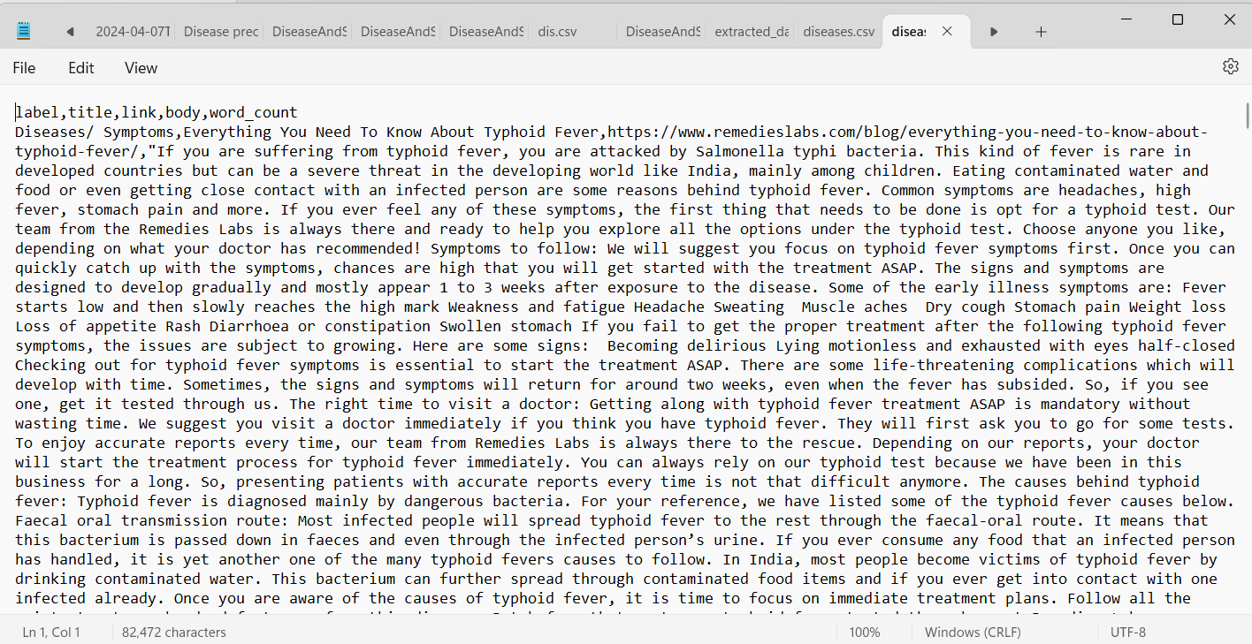
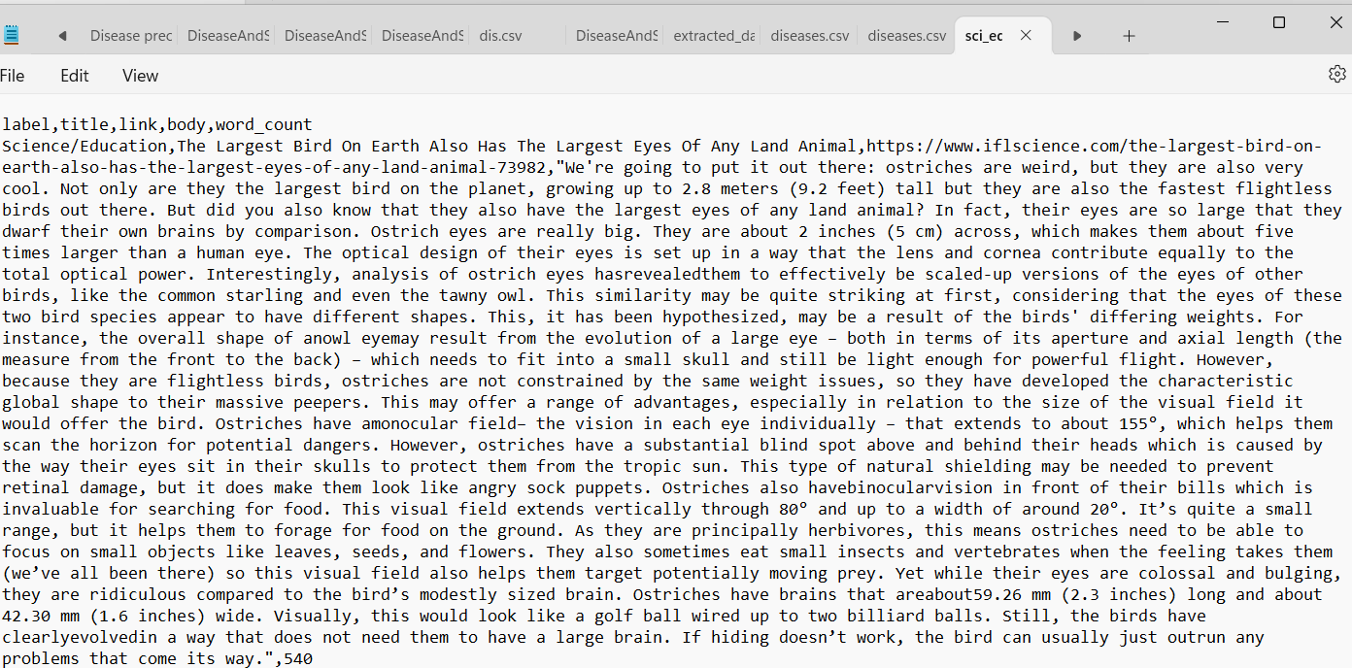
—Scrapped Data:

Slide 9
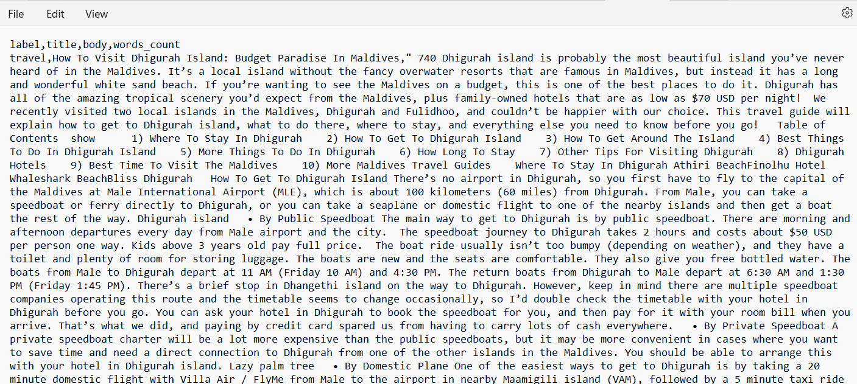
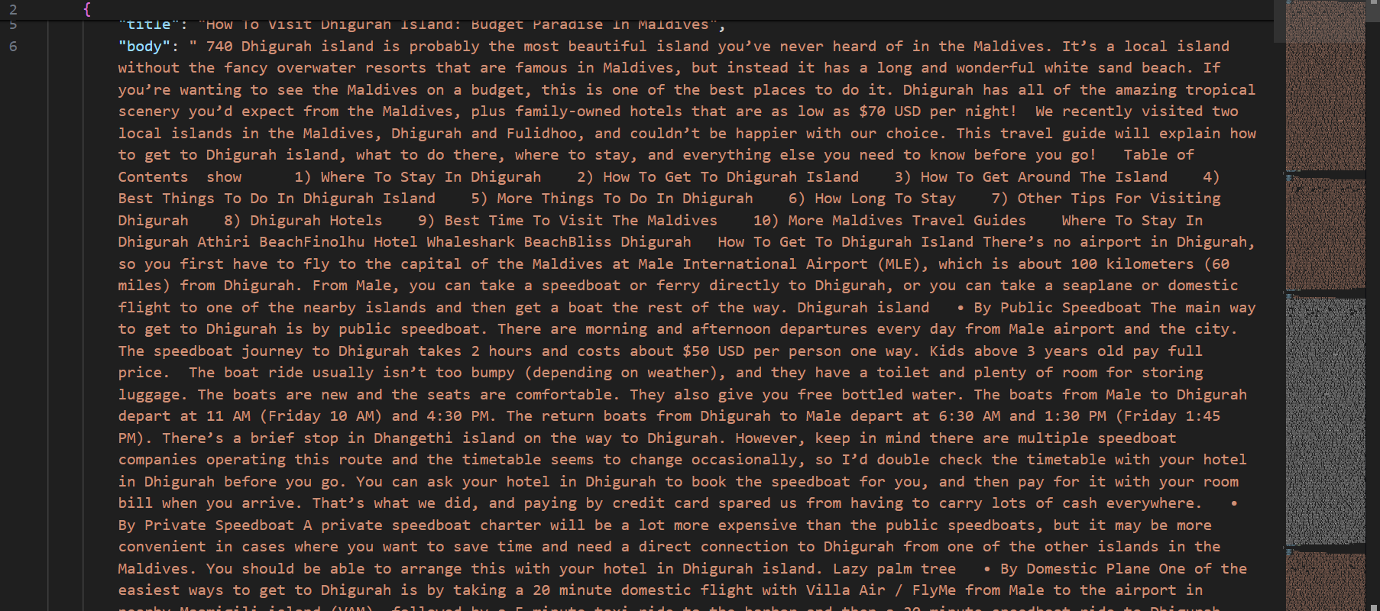
—Scrapped Data:

Slide 10
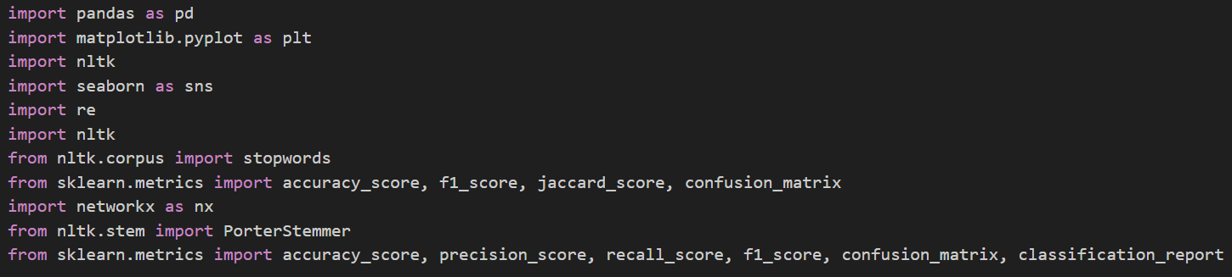
Libraries for graph plotting, NLP, confusión matrix !

Slide 11
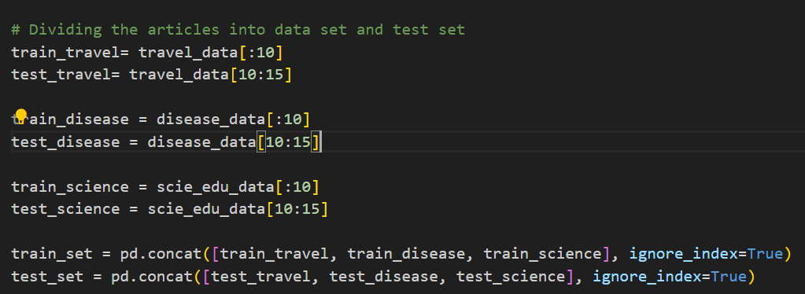
Dividing the articles into train data and test data

Slide 12
02
GRAPH CONSTRUCTION

Slide 13
NPL (Natural Language Processing)
Tokenization
Stop-Word Removal
Stemming
Splitting text into smaller meaningful units, like words or symbols, for analysis
Eliminating common, non informative words form text for enhanced analysis
Simplifying words to their root form for streamlined text processing

Slide 14
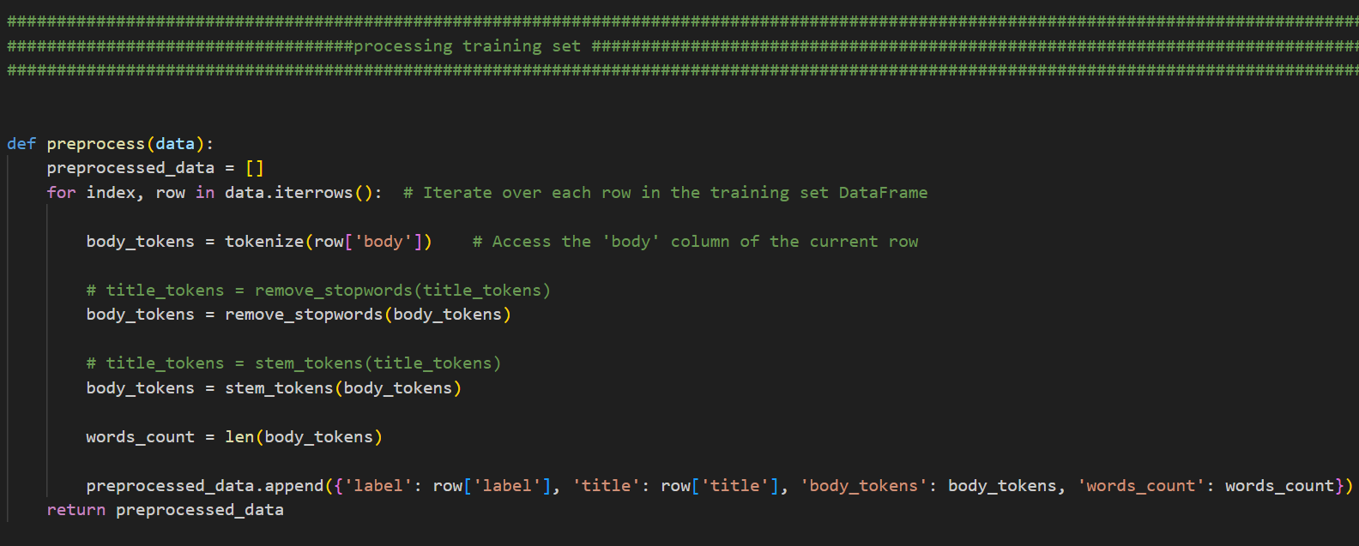
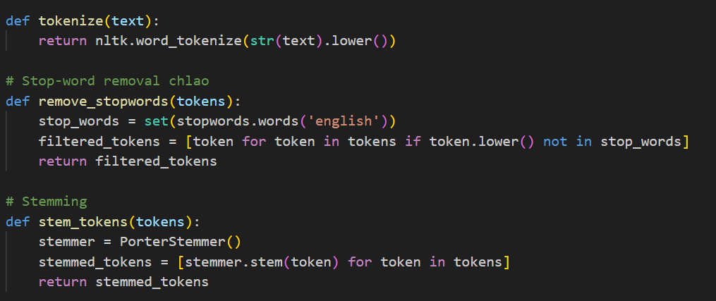
Implementation of NLP

Slide 15
Pre-processing training set

Slide 16
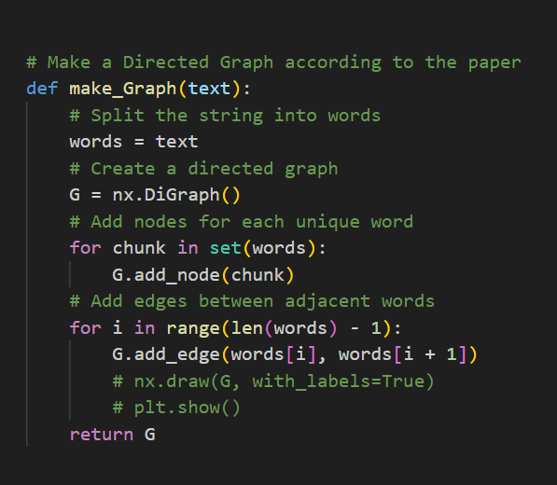
Making Directed Graph code

Slide 17
03
FEATURE EXTRACTION VIA COMMON SUBGRAPHS

Slide 18
COMMON SUBGRAPH FEATURE EXTRACTION
Extracting Shared Features
Capturing Document Relationships
Utilizing subgraph mining to identify common patterns among documents, forming features crucial for classification accuracy.
Identifying recurring subgraphs with training documents to encapsulate shared content, facilitating effective topic classification

Slide 19

DOCUMENT CLASSIFICATION: GRAPH-BASED KNN

Slide 20
04
CLASSIFICATION WITH KNN

Slide 21
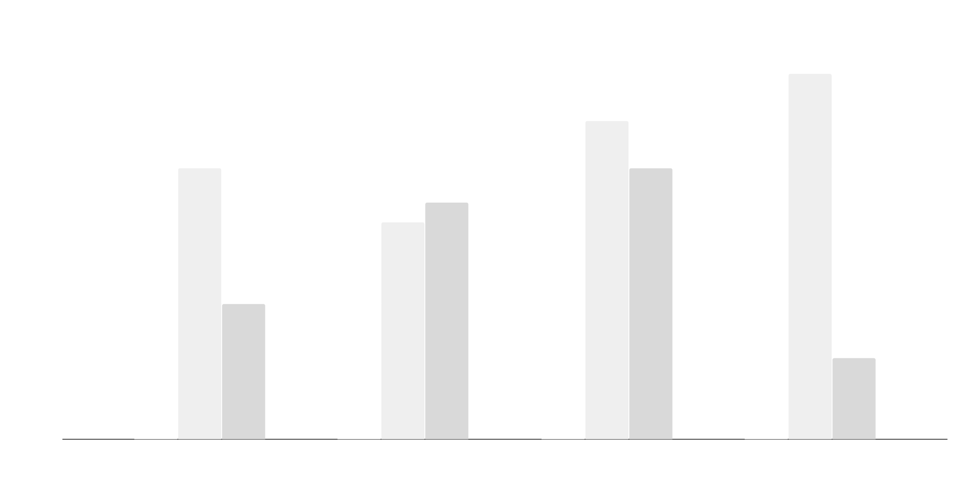
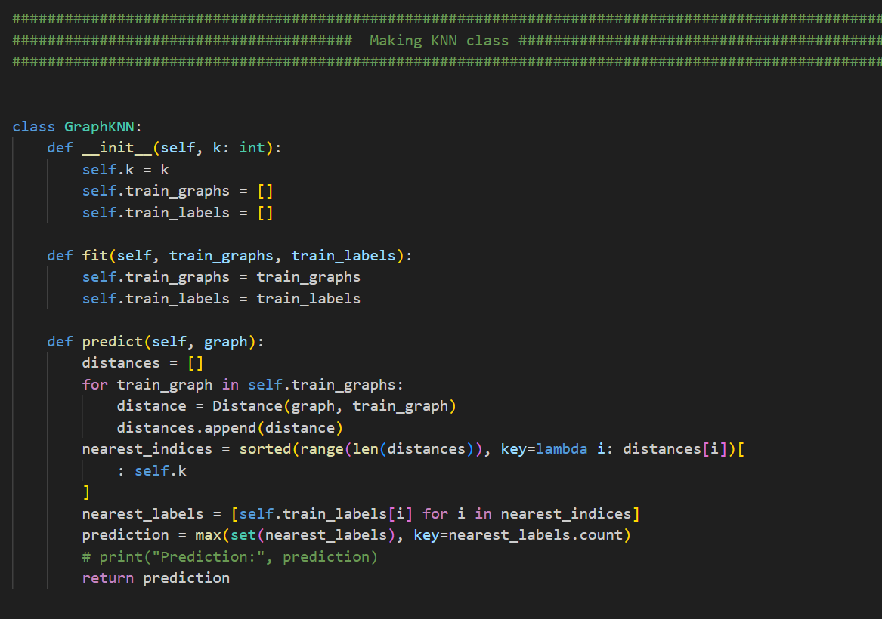
This code creates KNN Graph

Slide 22
05
Making Confusion Matrix

Slide 23
Confusion Matrix
“Grid detailing model performance by comparing actual versus predicted labels, aiding in understanding classification errors”

Slide 24
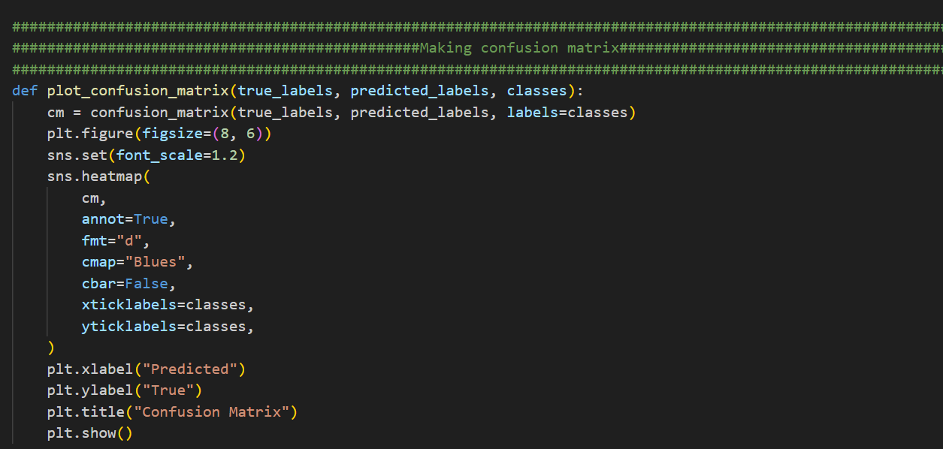
This code creates Confusion Matrix

Slide 25
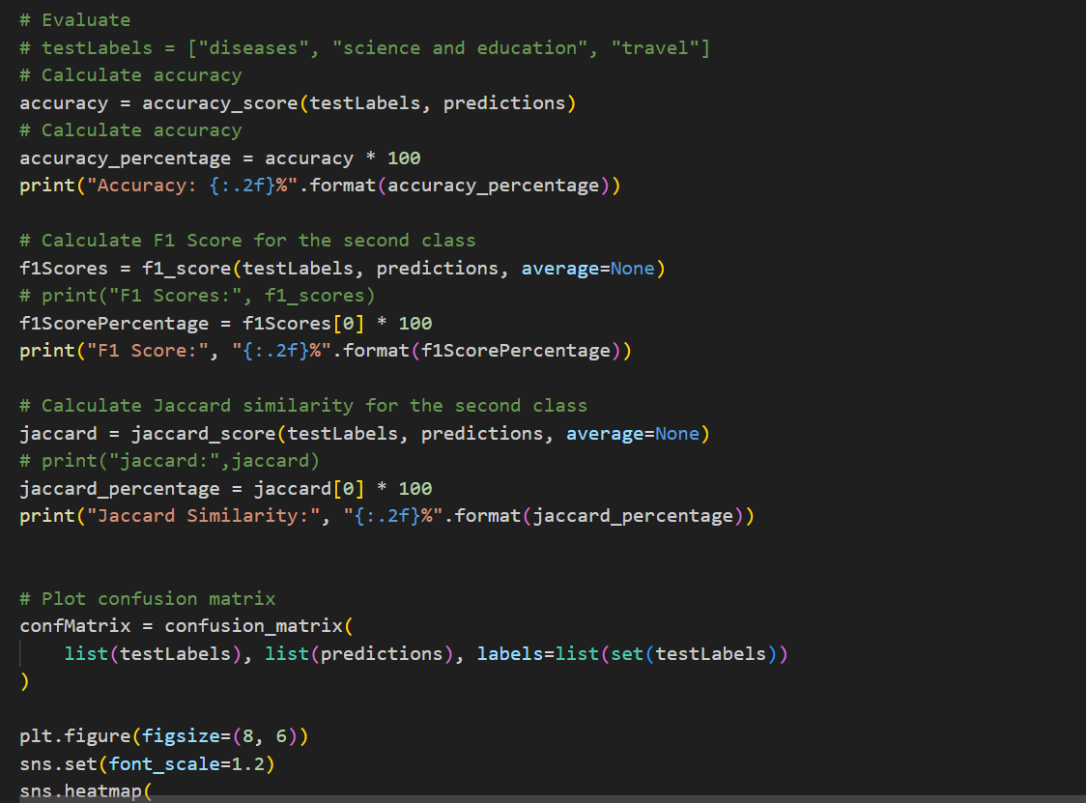
This code creates Confusion Matrix

Slide 26
OUTPUT

Slide 27

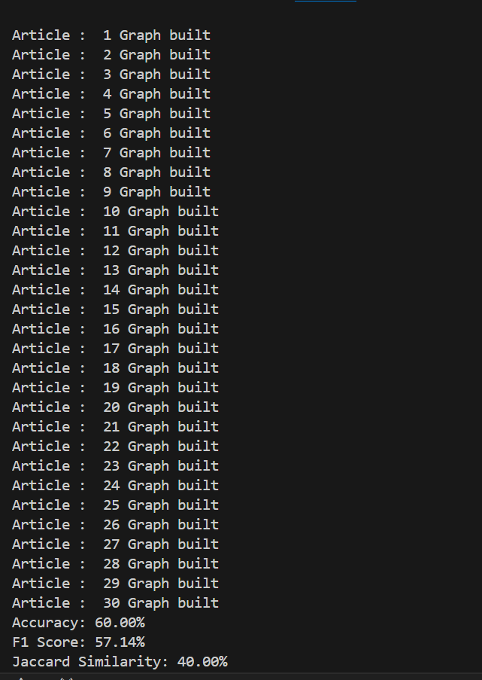
Graph Building

Slide 28
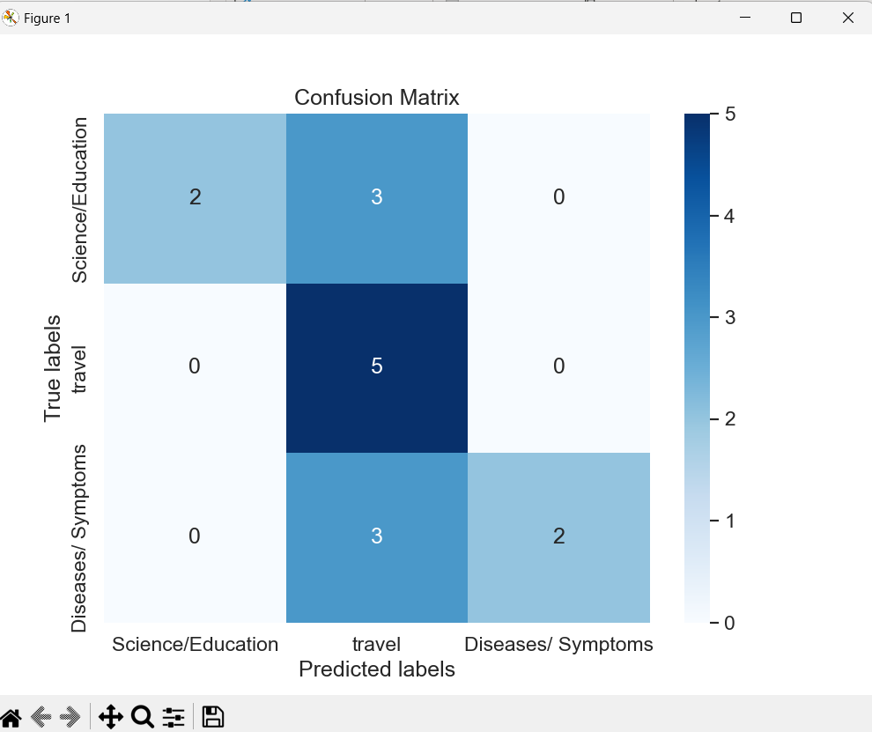

Slide 29
THANKS!
Does anyone have any questions?

